Slide 1
MAKING THE TREATMENT CASCADE WORK IN VULNERABLE AND KEY POPULATIONS
David Malebranche, MD, MPH
Associate Professor of Medicine
Morehouse School of Medicine
Atlanta, Georgia
United States of America

Slide 2
AIDS2020ForAll.org
#AIDS2020ForAll is a movement of advocates and networks working in the US and globally to ensure that the next International AIDS Conference (IAC) is accessible to those who want to come and most need to be there -- especially the communities most impacted by the global epidemic.
The International AIDS Society has made a decision to host the next IAC in San Francisco. This is unacceptable.
The U.S. is unsafe
Communities most impacted by the epidemic (sex workers, people who use drugs) will be unable to obtain visas.
IAS must move the conference.

Slide 3
“Vulnerable”
Capable of or susceptible to being wounded or hurt
Open to moral attack, criticism, temptation, etc.
(of a place); open to assault; difficult to defend

Slide 4
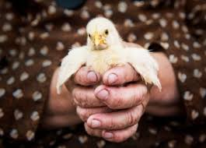
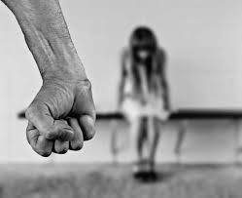
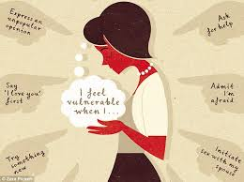
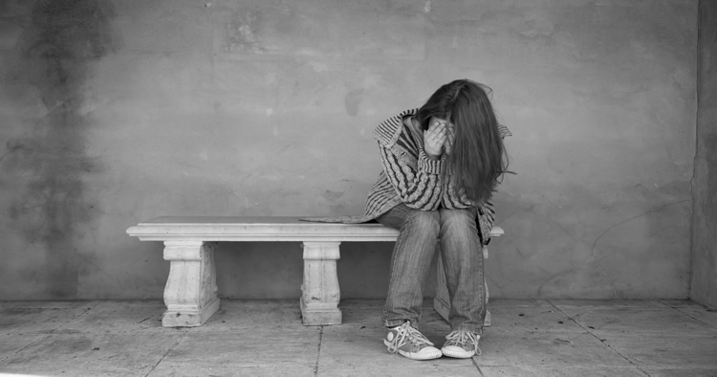
“VULNERABLE”

Slide 5
“IDIOT”

Slide 6
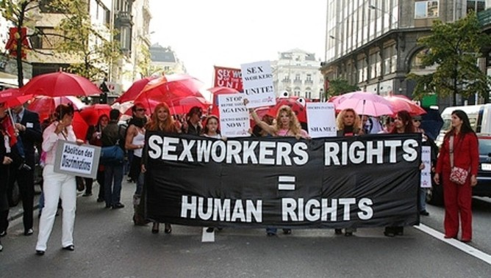
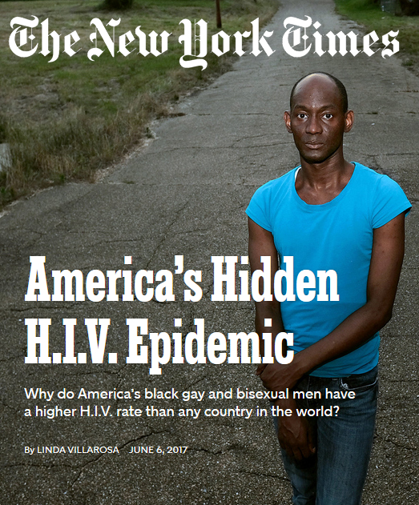
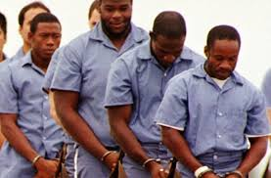
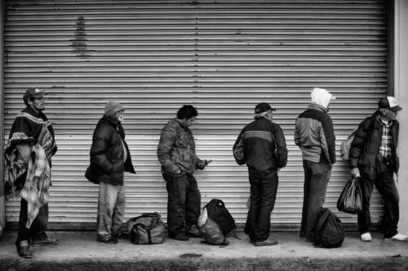
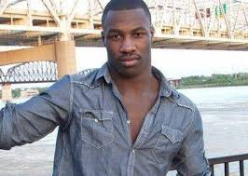
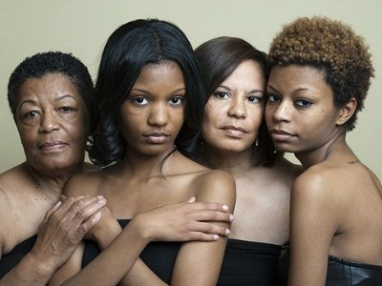
“Vulnerable” to HIV

Slide 8
Estimated HIV incidence in U.S., 2010-2015
Source: CDC. Estimated HIV Incidence and prevalence in the United States, 2010-2015. HIV Surveillance Supplemental Report 2018;23(No. 1).

Slide 10
HIV Treatment Cascade

Slide 14
MSM Racial Disparities along the Treatment Cascade
Rosenberg et al., 2014

Slide 15
Factors influencing viral suppression
Healthcare access
Insurance, Income, housing disparities
Positive ethnic/HIV identity formation
Less likely to “get” ART
Social capital
(Hussen et al., 2018; Harper et al., 2013; Beer et al., 2014; Hightow-Weidman et al., 2017)

Slide 17
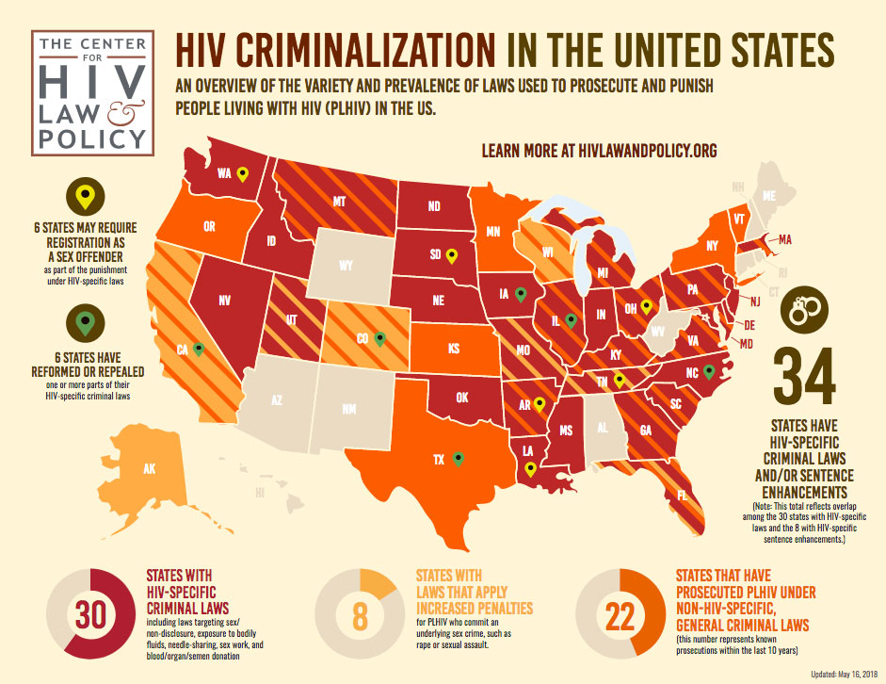

Slide 18
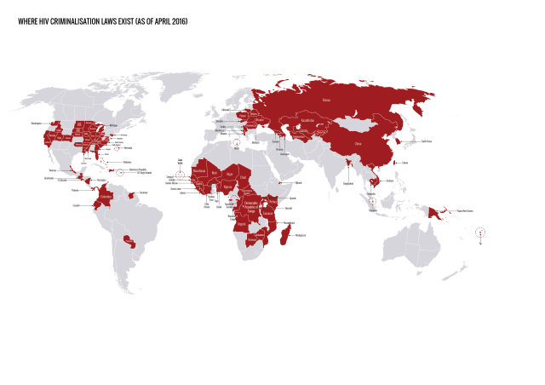
HIV Justice Network, 2016

Slide 19
Discrimination in Health Care
HIV stigma exists in medial clinics
China, Latin America & the Caribbean
Fear of discrimination among MSM deters health care utilization in Nigeria and Swaziland
Challenges with confidence with MSM sexual health counseling in Kenya
In the United States
Racial differences in providers’ communication styles about adherence
Non-white patients receive ART less, are less adherent, have lower viral suppression rates, and have higher rates of distrust than white patients
(Laws et al., 2014; Gaston et al., 2013; Li et al., 2007; Cloete et al., 2008; Taegtmeyer et al., 2013; Charurat et al., 2015; Pineirua et al., 2015)

Slide 20
Examining the Treatment Cascade

Slide 21
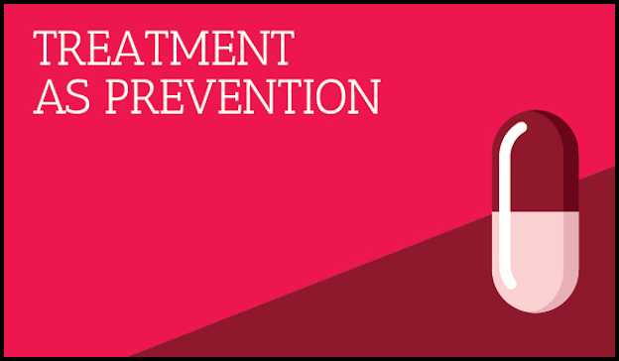
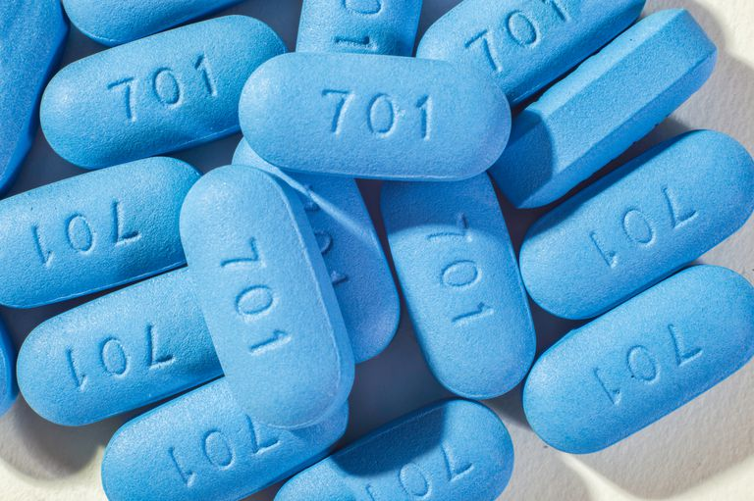
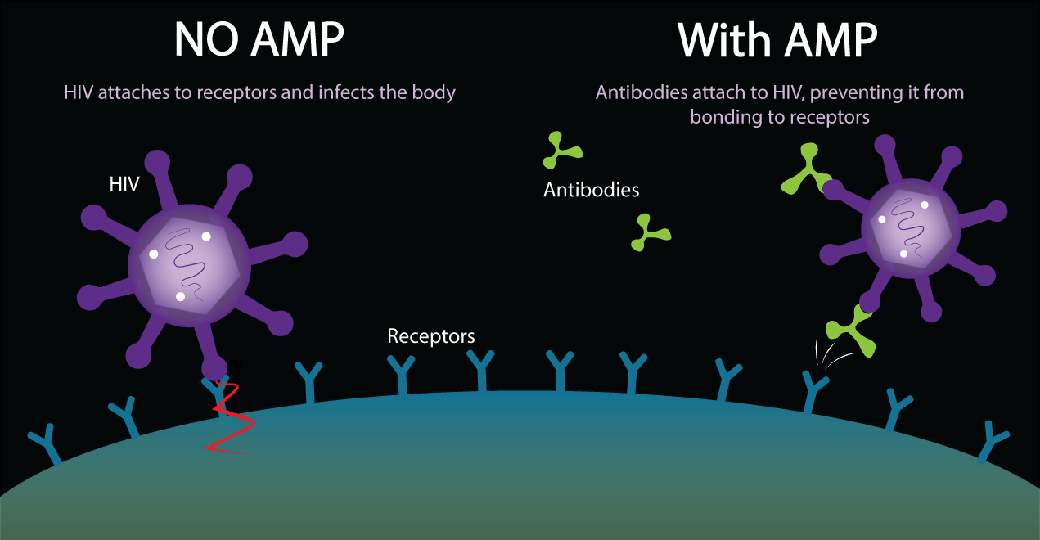
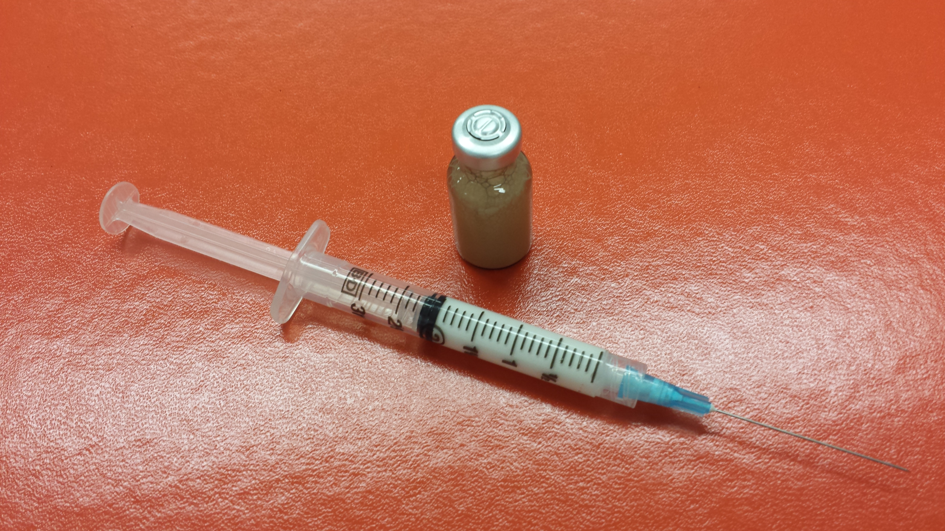

Slide 22
Solutions???
Peer navigation, Patient reminders, Rapid test and treat options, Mobile medical teams, Case manager interventions
Social interventions (housing, food, employment, education)
General health initiatives – health is NOT just HIV
Getting rid of anti-LGBT and HIV Criminalization Policies
Home grown community interventions

Slide 23
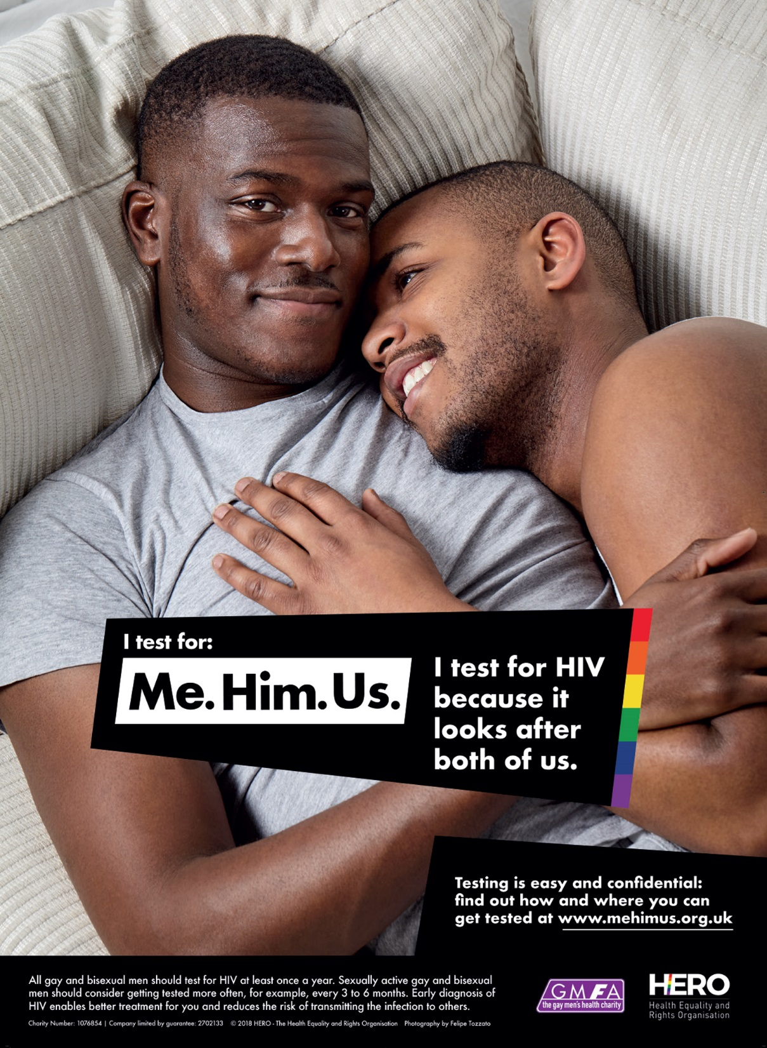
Community First…
HIV TESTING

Slide 24
LINKAGE
Karwa et al., 2017

Slide 25
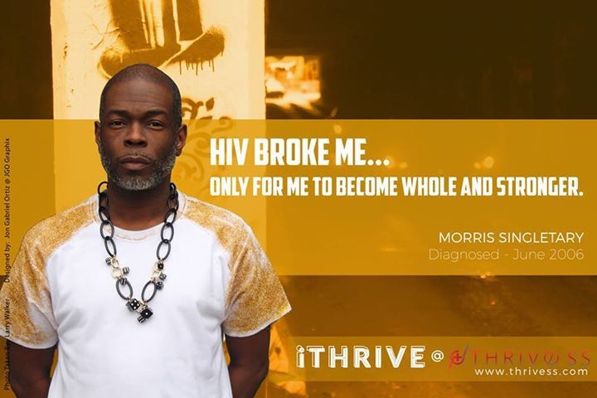
VIRAL SUPPRESSION

Slide 26
Be Vulnerable

Slide 28
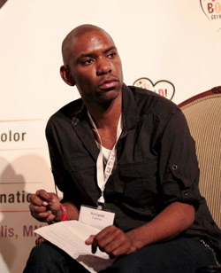
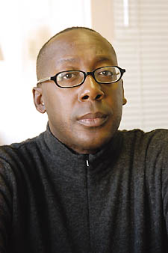
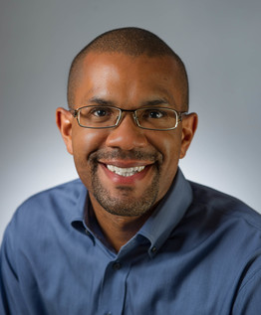
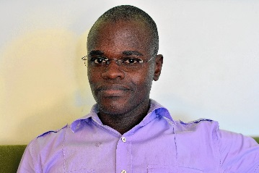
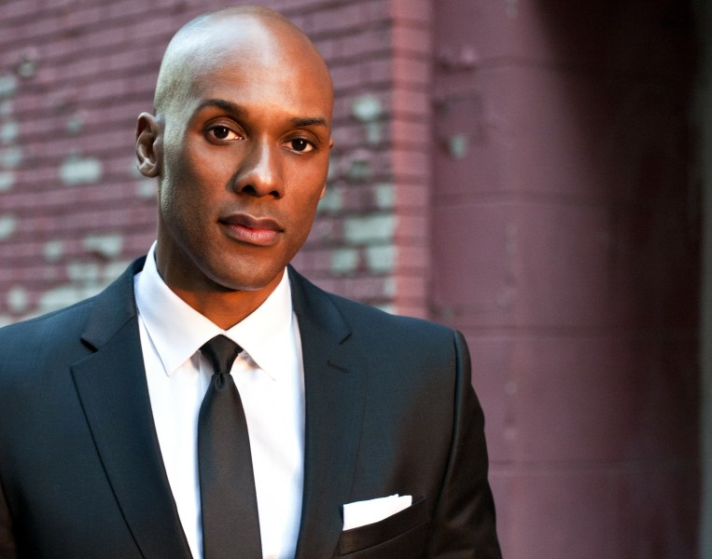
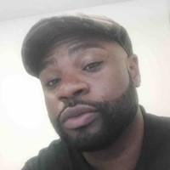
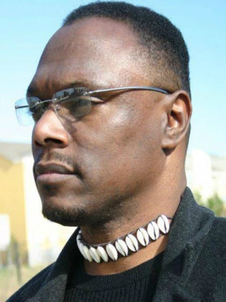
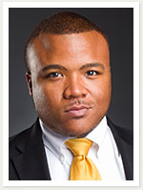
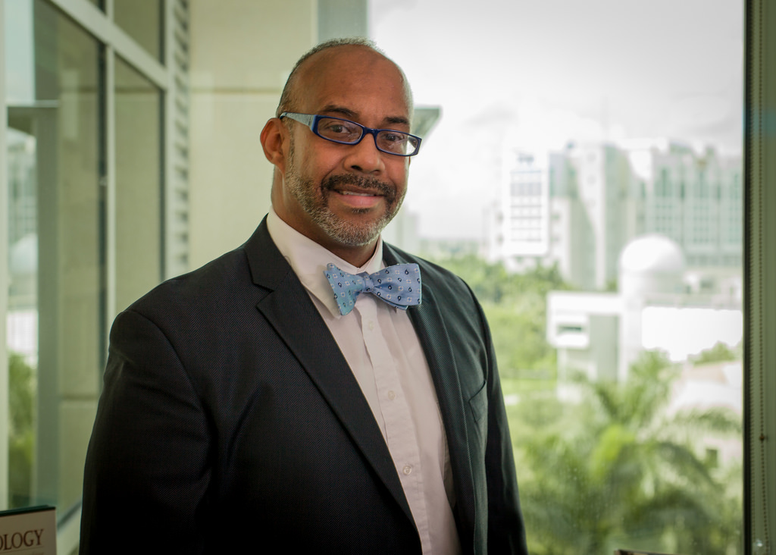
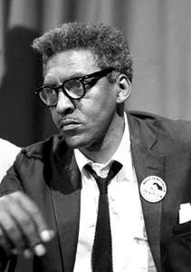
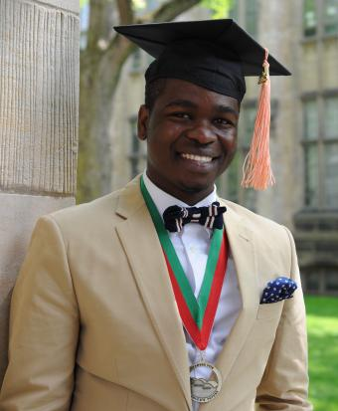
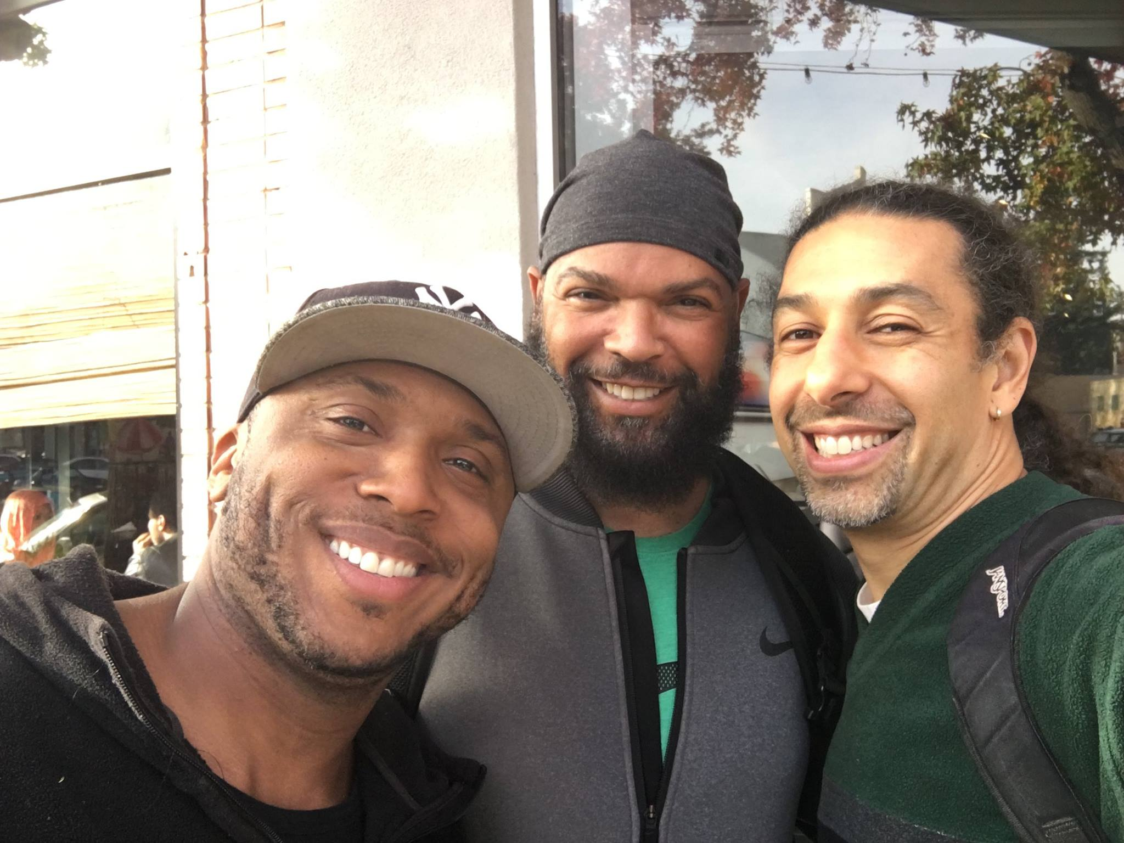
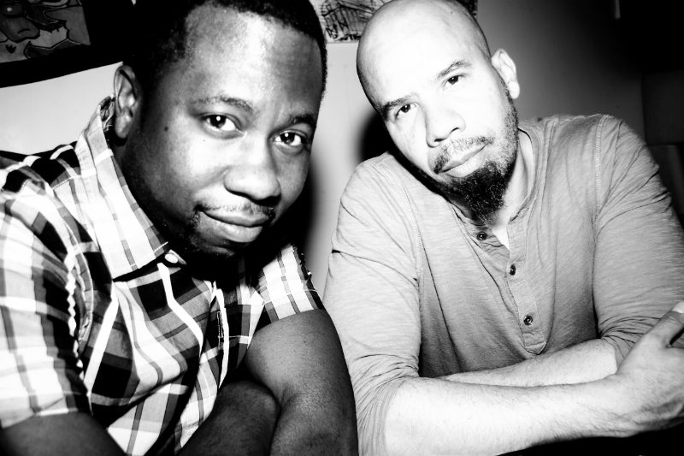
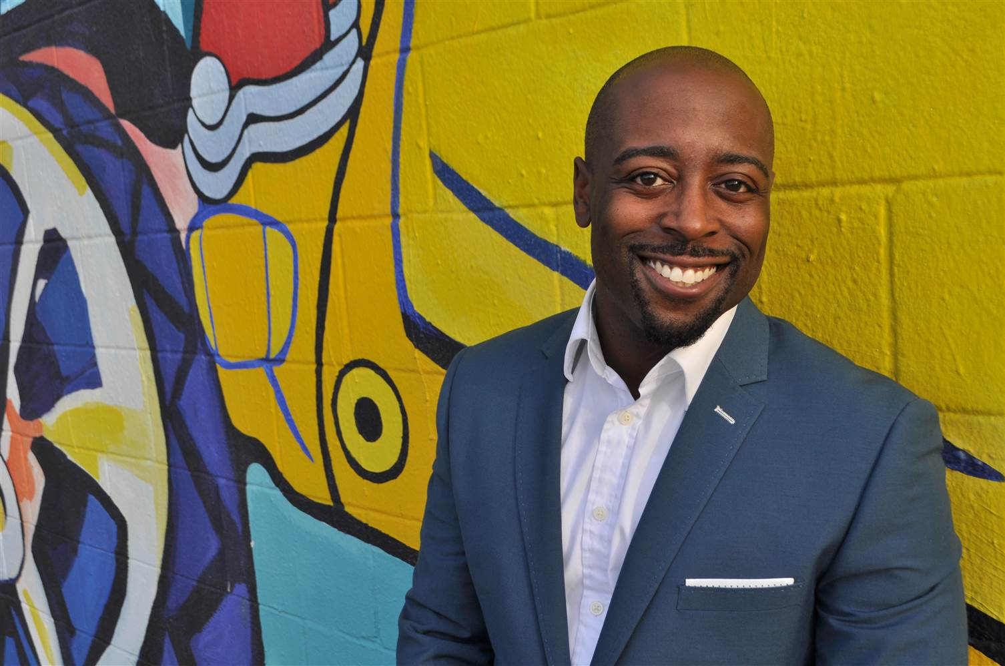
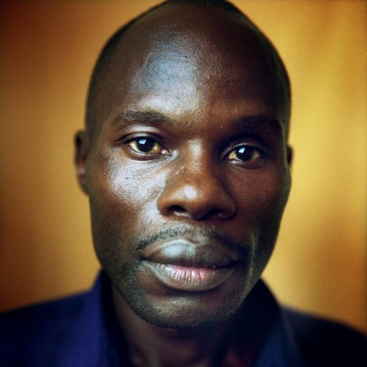
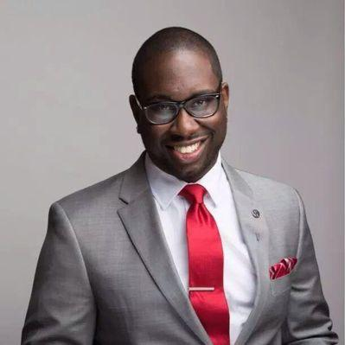
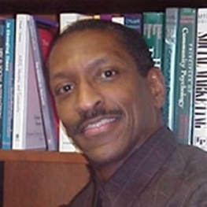
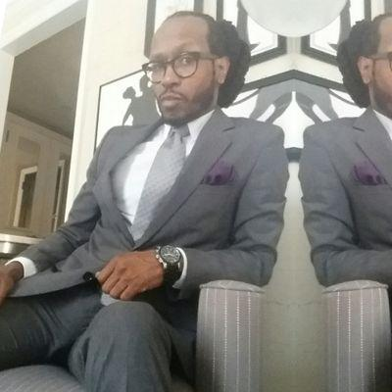
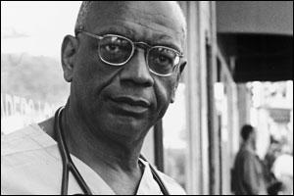
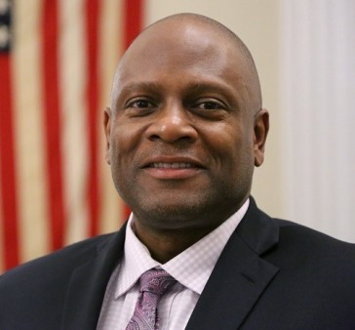
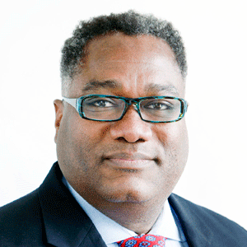
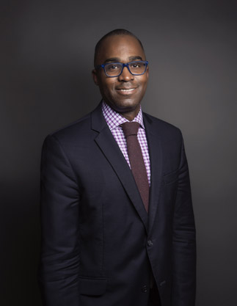
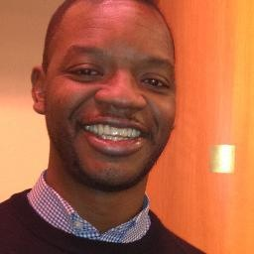
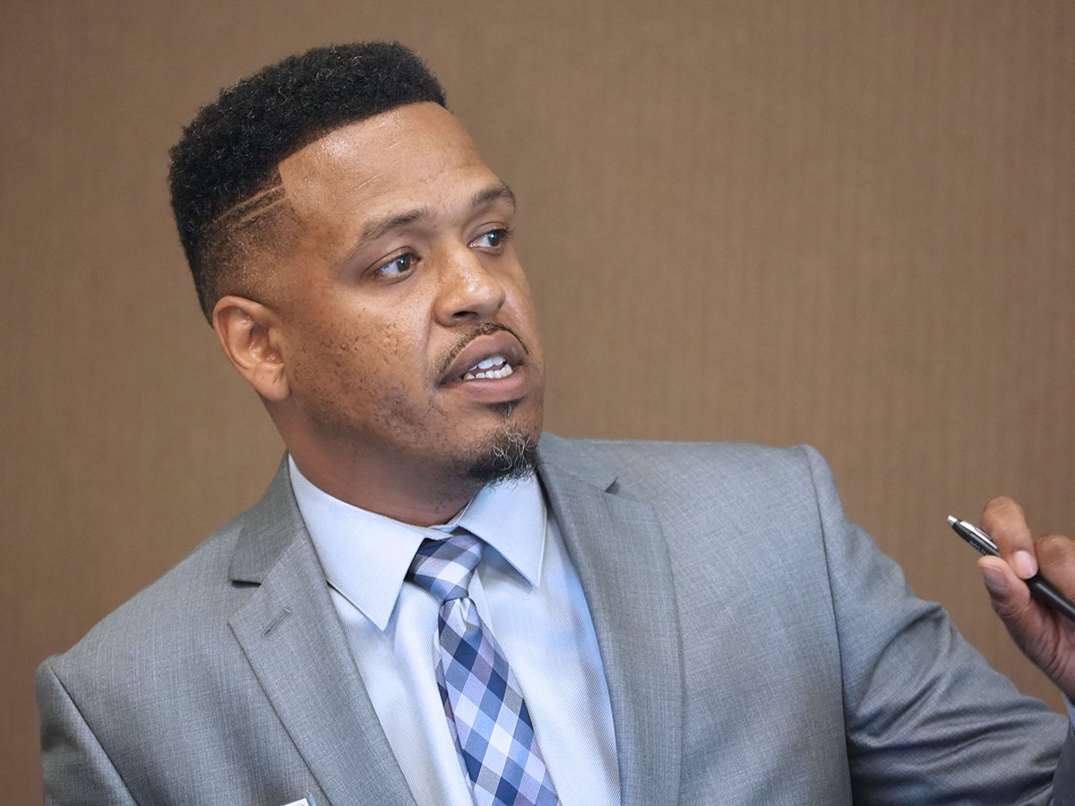
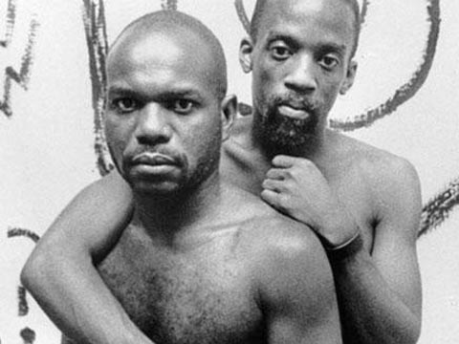
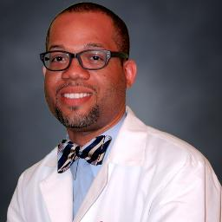
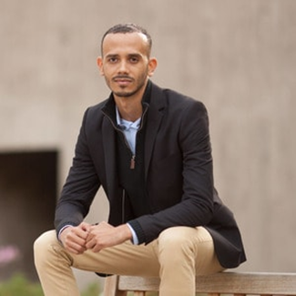
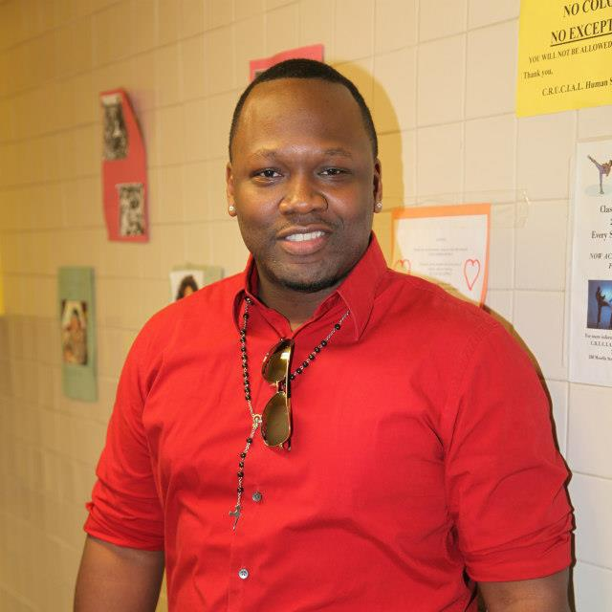
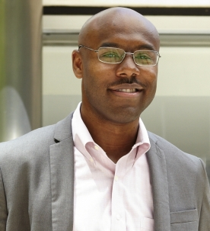
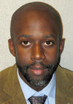
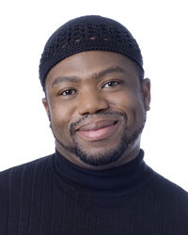
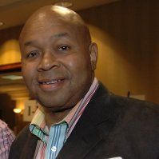

Slide 29
Sexual Health Cascade
“Linked” to Family, Friends, and Community
“Engaged” with each other
Sexual Health “Expression”
“Positive” Racial and Sexual Identity

Slide 30
THANK YOU!!!!

